Slide 1

Persian vqa
Maryam Sadat Hashemi
Alireza Asghari

Slide 2
Outline
Task
dataset
network

Slide 3
Task
آبی
PVQA System
اتوبوس چه رنگی است ؟

Slide 4
Dataset : VQA V1 Real Images
Questions : 614,163
Training questions : 248,349 questions
Validation questions : 121,512 questions
Testing questions : 244,302 questions
Images : 204,721
Training images : 82,783 images
Validation images : 40,504 images
Testing images : 81,434 images
Annotations : 3,698,610‬
Training annotations : 2,483,490 answers
Validation annotations : 1,215,120 answers
For every image :
3 questions
For every question :
10 open-ended answers

Slide 5


Dataset : VQA V1 Real Images (Persian)

Slide 6
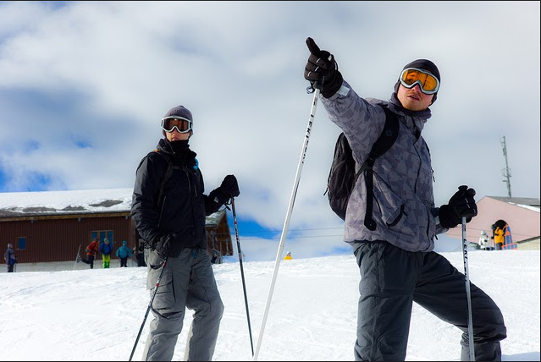
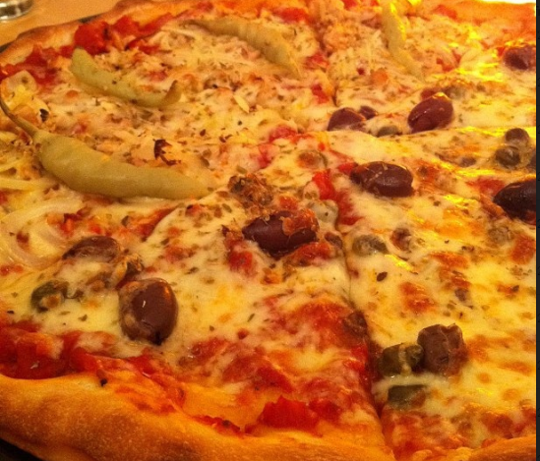
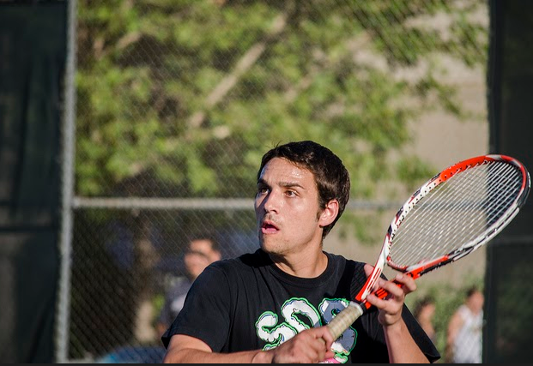
Dataset : VQA V1 Real Images (Persian)
Are there clouds in the sky?
What toppings are on the pizza?
What is the man's expression?
ابرها در آسمان هستند؟
چه چیزی روی پیتزا است؟
چهره مرد چیست؟
آیا ابرها در آسمان وجود دارند؟
پیتزا چیست؟
بیان مرد چیست؟

Slide 7
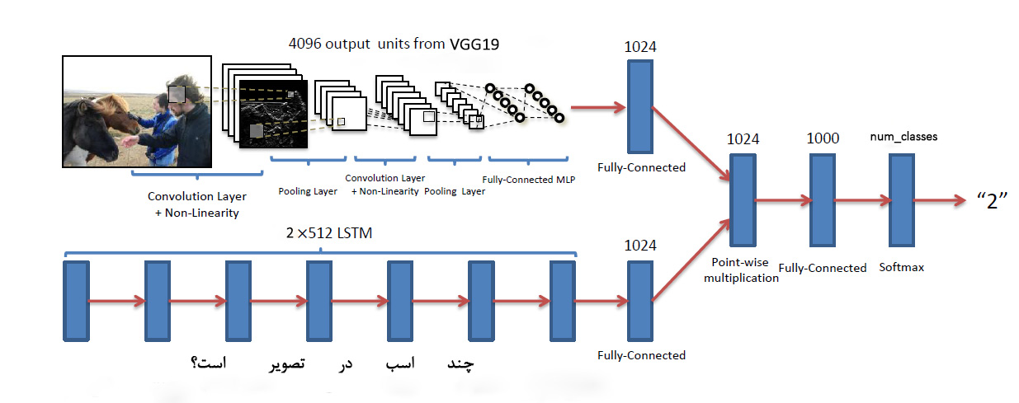
Network

Slide 8
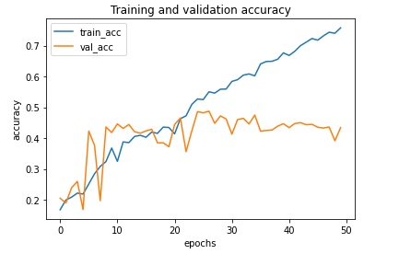
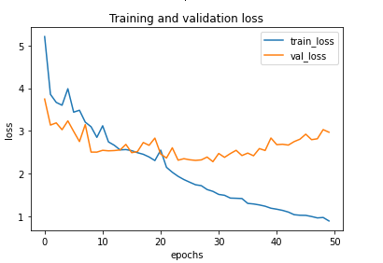
Primary Results
3000 Train
1500 Val
1500 test
300 +1 classes
Without pretrained embedding

Slide 9
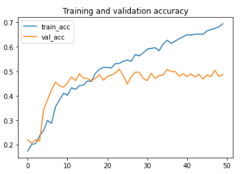
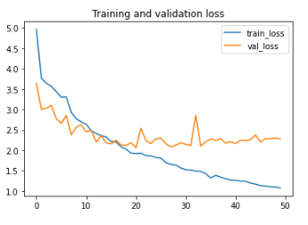
Primary Results
3000 Train
1500 Val
1500 test
300 +1 classes
With fasttext (english)

Slide 10
Primary Results
Method | Accuracy
LSTM Q + I(baseline paper in English VQA v1) | 53.74
LSTM Q + I(Our Implementation in English VQA v1+fasttext with 3000 questions) | 48.7
LSTM Q + I(Our Implementation in Persian VQA v1 with 3000 questions) | 43.39

Slide 11
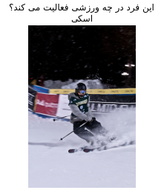
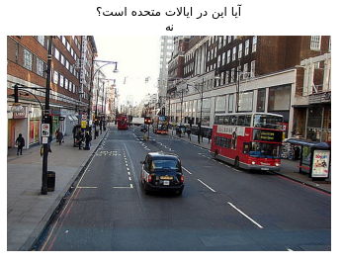
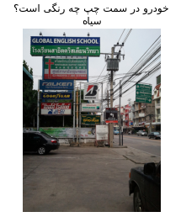
prediction
Ground Truth

Slide 12
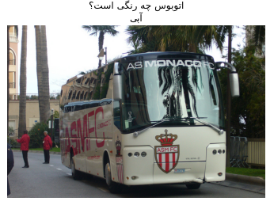
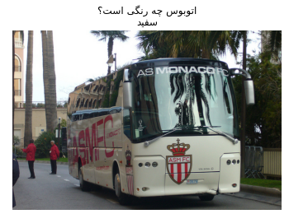
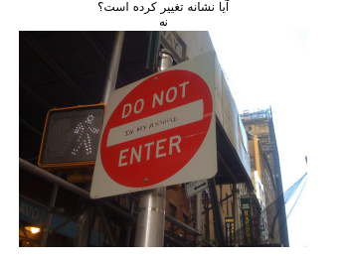
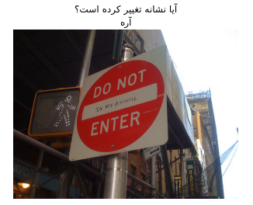
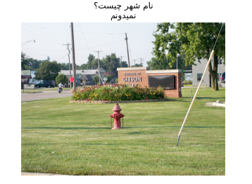
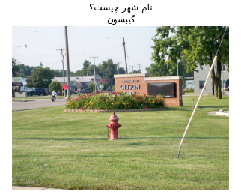
prediction
Ground Truth

Slide 13
Plan
Implement State of the Art models
Test our baseline model with the whole of our dataset and different flavors

